Slide 1
Delivery Carrier
How to bring us forward!
A guide to Mango's delivery process and carrier management

Slide 2

Training are not an expense, but an investment in Human Capital
Transcom
Roy H Williams, 2001
|

Slide 3

Introduction to Mango's Delivery Service
Our Goal: To provide the best possible shopping experience with reliable and secure delivery.
Carrier Variety: We work with various trusted carriers, which may differ by country, shipping type, destination, and online store (Mango.com or Mangooutlet.com).
Automatic Assignment: The system automatically assigns carriers when orders ship from the warehouse.
Pre-Shipment Confirmation: We usually cannot confirm the specific carrier to the customer before shipping unless only one carrier is used in the country.
|

Slide 4
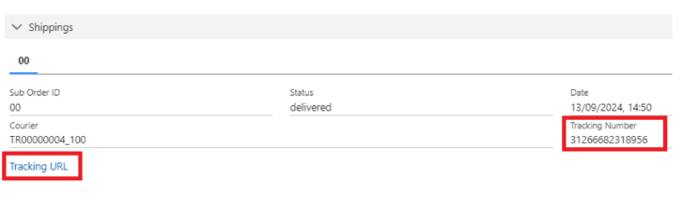
Tracking Orders: Accessing & Sharing Information
Internal Tracking: You can find carrier and tracking details in Salesforce:
Click "Tracking URL" in the "Order" section.
Check the "Order > Shippings" tab.
Customer Tracking: Customers can track their orders via:
Link in "My Purchases" on their account.
Automatic emails from Mango and the carrier.
Guest users: "My Purchases > I am not registered."
Sharing Details: Provide customers with the tracking link so they can get real-time updates and carrier contact details.
|

Slide 5
Customer Interaction with Carriers Post-Shipment
Direct Contact: After shipment, customers can contact the carrier to:
Arrange a suitable delivery time.
Confirm the exact delivery date.
Inquire about delivery conditions (e.g., delivery attempts, collection point options, delivery days).
Empowering Customers: Encourage customers to contact the carrier directly for specific delivery requests or clarifications once the package has shipped.
|

Slide 6
Internal Resources for Carrier Information & Importance
Accessing Details: Internal documents provide contact numbers and delivery conditions:
"Delivery conditions of each carrier" in the "Cuestionarios Transportistas" folder.
"Courier telephone numbers excel" document.
"Transport Manual" (couriers per country).
Note: Use ATCXXX@mango.com login & try incognito if encountering errors.
Why This Matters: Knowing each carrier's terms is vital to:
Provide accurate information to customers.
Identify contract breaches by carriers.
Correctly classify customer cases (information vs. complaint).
|

Slide 7
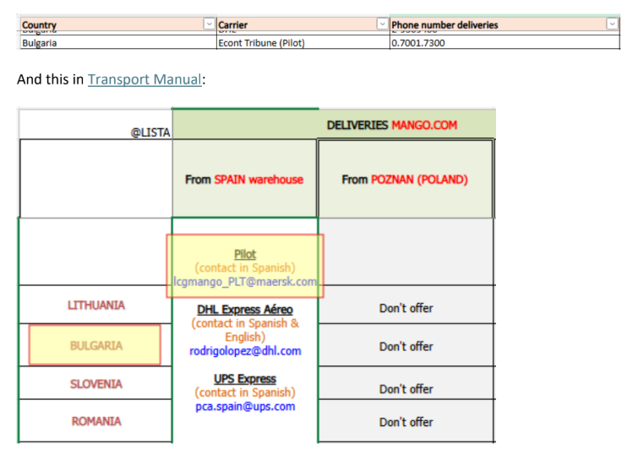
Subcontracted "Last Mile" Deliveries & Contact Procedures
"Last Mile" Concept: Some carriers subcontract the final delivery leg to local carriers in the destination country.
Intermediary Role: Mango's contracted carrier (e.g., Pilot) acts as an intermediary for bulk shipment.
Who to Contact:
For general delivery inquiries or changes before local handover, contact the intermediary (e.g., Pilot).
To provide customers with contact details for delivery arrangements, provide the final local carrier's details once the package is at the destination and visible in tracking.
|

Slide 8
Store Deliveries & Process
Mango's Internal Carriers: Store deliveries are handled by Mango's internal carriers.
No External Tracking: No external tracking is available, and there's no direct carrier contact for agents or customers.
Automated Emails:
Email 1: Sent when the order leaves the warehouse, informing the customer it's on its way.
Email 2: Sent when the order arrives at the store, informing the customer it's ready for collection and providing collection details.
|

Slide 9
Let´s be brilliant together!
Quality and Training Team Mango and Transcom,
April 2025
|

